Slide 1
Introduction to Javascript
Computer Class
14 JULY 2019

Slide 2
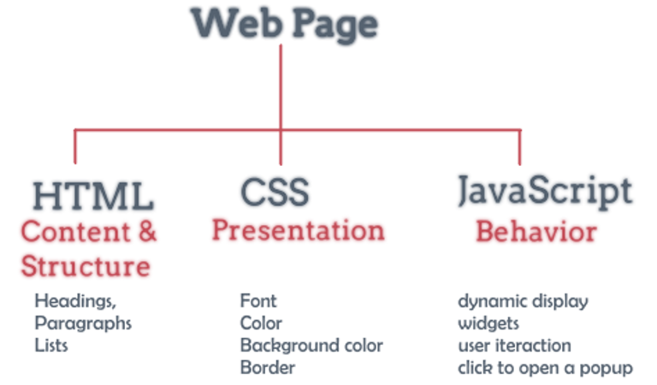
Recap (Revision)
How modern websites work
Three components on client side
Webpages: HTML
Styling (font size and color etc): CSS
Scripting: Javascript

Slide 3
HTML
<!DOCTYPE html> <html> <title>HTML Example</title> <body> <h1>This is a heading</h1> <p>This is a paragraph.</p>
<p><a href="https://www.fgs.org">Fo Guang Shan</a></p> </body> </html>

Slide 4
CSS
Cascading style sheets
body { background-color: lightblue; } h1 { color: white; text-align: center; } p { font-family: verdana; font-size: 20px; }

Slide 5
Javascript
var a = 5;
if (a === 6) {
alert(‘a is 6’)
} else {
alert(‘a is 5’);
}

Slide 6
About JavaScript
It is a lightweight programming language
Used to make webpages interactive
Interpreted, not compiled
Easy to learn
It is safe (cannot access memory, data in other tabs, cannot control your webcam)
<html>
<body>
<script type="text/javascript">
document.write("Hello World!")
</script>
</body>
</html>

Slide 7
How to run JavaScript code
Press F12 on your web browser
Go to “Console”
Write click on webpage and select ”inspect”
https://www.w3schools.com/html/tryit.asp?filename=tryhtml_default
Homework: Look at source code and Javascript of these websites:
www.timesofindia.com
www.fgs.org.tw
www.google.com

Slide 8
Variables
var foo;
foo=1; blah="Hi Dave";
alert(foo)
let b0 = 4;
let b1 = 5;
var c = b0 + b1;
prompt(c);
var b2 = “hello”;
prompt(b1 + b2);

Slide 9
Functions
function add(x, y) {
alert(x + y);
}
add(3,4)
function f() {
var a = prompt(“Enter a”);
var b = prompt(“Enter b”);
c = a + b;
alert(“c is = “ + c);
}
f()

Slide 10
Adding two numbers
<SCRIPT>
function add(x,y) {
return(x+y);
}
document.write("add(3,4) is " + add(3,4) + "<BR>");
</SCRIPT>

Slide 11
Document.write
document.write() like a print statement – the output goes into the HTML document.
document.writeln() adds a new line after printing.
document.write("My title is" + document.title);

Slide 12
Document.write
<HEAD>
<TITLE>JavaScript lesson</TITLE>
</HEAD>
<BODY>
<H3>I am a web page and here is my name:</H3>
<SCRIPT>
document.write(document.title);
</SCRIPT>
<HR>

Slide 13
Alert and confirm and prompt
<script>
confirm("Hello FGS, are you sure?");
var myname = prompt(“enter your name”);
alert(myname);
x=5;
y=6;
alert(“Sum of x and y is = “, x + y)
</script>

Slide 14
For loop
for(i = 0; i<5; I++)
{
alert(i);
}

Slide 15
While loop
var i = 0;
while( i < 5 )
{
alert(i);
i++;
}

Slide 16
If … else condition
if (condition) {
statements;
} else if (condition) {
statements;
} else {
statements;
}
var i = 0;
if( i < 5 )
{
alert( i + “is less than 5” );
}
else
{
alert( i + “is more than 5”);
}

Slide 17
Switch statement
Var a = 5;
Switch(a)
{
case 5:
alert(“a is 5”);
default:
alert(“a is not 5”);
}

Slide 18
Comments
// This is how we make comments
alert(“hello world”);
/*
this is also how we make comments
*/

Slide 19
Maximum of numbers
<SCRIPT TYPE = "text/javascript">
var input1 = prompt( "Enter first number", "0" );
var input2 = prompt( "Enter second number", "0" );
var input3 = prompt( "Enter third number", "0" );
var value1 = parseFloat( input1 );
var value2 = parseFloat( input2 );
var maxValue = maximum( value1, value2 );
alert( "Maximum is: " + maxValue );
function maximum( x, y )
{
if(x>y)
return x;
else
return y;
}
</SCRIPT>

Slide 20
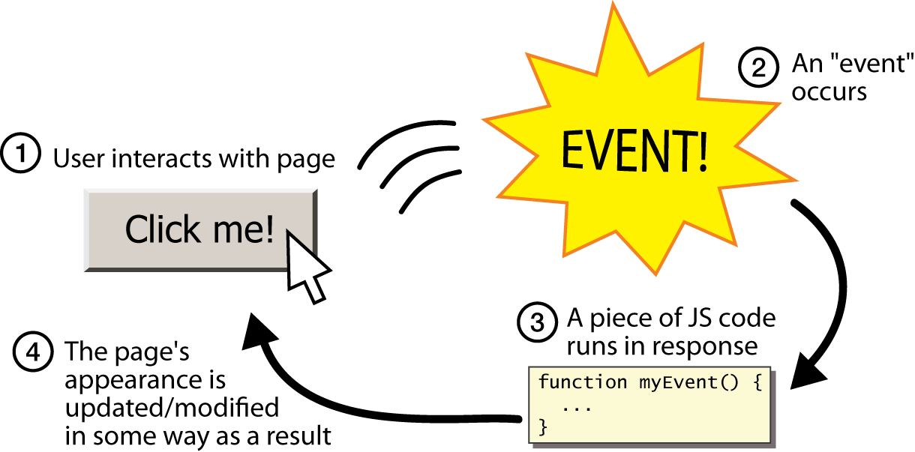
Events in Javascript
split breaks apart a string into an array using a delimiter
can also be used with regular expressions (seen later)
join merges an array into a single string, placing a delimiter between them
<button onclick="myEvent();">
Click me!
</button> HTML

